Slide 1

Department of CSE-AI & ML (CSM)
Team:BATCH17
21BQ5A4206, 21BQ5A4204,
21BQ5A4205, 21BQ5A4201
Project Title:
FOODSNAP: A Deep Learning Based Dietary Management and Food Analysis Application
TEAM MEMBERS:
21BQ5A4206 – Sk. Esub
21BQ5A4204 P. Sattar Khan
21BQ5A4205 – P. Sandeep
21BQ5A4201 – A. Sai Srija
Under the Guidance of:
(Project Guide) HOD-CSM,
Dr.V.Muralidhar Dr.K.Suresh Babu

Slide 2
Department of CSE-AI & ML (CSM)
Team:BATCH17
21BQ5A4206, 21BQ5A4204,
21BQ5A4205, 21BQ5A4201
Abstract:
The "Mobile Application for Diet Recall" is an innovative and comprehensive project that aims to revolutionize dietary management through the use of Deep Learning and Natural Language Processing (NLP) techniques. The application functions as an AI-based smart food analyzer and dietary tracking tool, allowing users to accurately record and monitor their food intake using a user-friendly diet recall approach. The app's advanced Deep Learning algorithms delve into a vast food database to provide users with detailed nutritional information, including calories, carbohydrates, fats, and proteins. Additionally, the application utilizes NLP to enhance user interaction, allowing for seamless customization of profiles with personal information and dietary preferences. With personalized dietary recommendations, meal suggestions, and advanced analytics,the project empowers users to make informed choices about their dietary habits and health.
The existing system faces several key problems. First, traditional calorie trackers rely on manual food recording, which can be time-consuming and tedious for users. Second, the lack of ease-of-use in entering food names or recording unnamed foods hinders the accuracy of data input. Third, the application's inability to handle regional language pronunciations limits its accessibility to users from diverse linguistic backgrounds. Additionally, the existing system lacks crucial alerts related to dietary tracking and allergens, compromising usersafety and awareness.

Slide 3
Department of CSE-AI & ML (CSM)
Team:BATCH17
21BQ5A4206, 21BQ5A4204,
21BQ5A4205, 21BQ5A4201
The proposed solution addresses these issues comprehensively. By employing Deep Learning and image recognition, users can record their meals effortlessly by simply taking a picture, eliminating the need for manual data entry. The app's auto-suggestion feature streamlines food recording with optimized text input. Moreover, the integration of NLP enables the app to understand food names pronounced in regional languages, ensuring inclusivity and ease of use. The proposed solution also implements diet tracking alerts and allergen alerts, promoting user safety and health-conscious decision-making. Overall, the project's proposed solution promises to provide a seamless and comprehensive dietary management experience, fostering healthier eating habits and improved well-being for users.
Functional Requirements :
User Registration and Profile:
Allow users to create accounts using email or social media accounts.
Implement password recovery and account verification processes.
Provide options for users to customize their profiles with personal information and dietary preferences.
Enable users to set their dietary goals and fitness objectives in their profiles.
Nutritional Analysis:
Utilize a vast food database to accurately analyze the nutritional content of food items.
Display detailed information about calories, carbohydrates, fats, and proteins for each food entry.
Calculate and display the daily recommended intake of nutrients based on the user's profile and goals.
Provide a breakdown of nutritional information in charts and graphs for better visualization.

Slide 4
Department of CSE-AI & ML (CSM)
Team:BATCH17
21BQ5A4206, 21BQ5A4204,
21BQ5A4205, 21BQ5A4201
Meal History and Tracking:
Maintain a comprehensive meal history, allowing users to review their past food entries.
Implement a search and filter functionality to easily find specific meals within the history.
Enable users to add notes or comments to individual meal entries for better context.
Provide a timeline view for users to track their eating patterns and habits over time.
Goals Setting and Tracking:
Allow users to set specific health and dietary goals, such as weight loss, muscle gain, or nutrient intake targets.
Provide progress tracking for each goal with visual indicators of achievements.
Send periodic progress updatesto users and congratulate them on reaching milestones.
Allow users to modify or update their goals as needed based on their progress.
Offline Functionality:
Implement offline access to the application, allowing users to record meals and view previous entries without an internet connection.
Sync data with the cloud once the internet connection is restored.
Provide real-time feedback on nutritional analysis and dietary recommendations even when offline.
Store user settings and preferences locally to ensure a seamless experience when offline.

Slide 5
Department of CSE-AI & ML (CSM)
Team:BATCH17
21BQ5A4206, 21BQ5A4204,
21BQ5A4205, 21BQ5A4201
Personalized Recommendations:
Analyze user data, dietary habits, and nutritional intake to generate personalized dietary recommendations.
Offer meal suggestions and recipe ideas based on the user's dietary preferences and restrictions.
Provide tailored nutritional advice to address specific health concerns or conditions.
Offer personalized goal-setting based on the user's current health status and future objectives.
Visual Analytics:
Generate comprehensive analytics on the user's overall nutritional intake and eating patterns.
Display data in interactive charts and graphs for easy understanding and analysis.
Offer insights and trends based on the user's eating habits over time.
Provide comparisons between actual intake and recommended dietary guidelines.
Reports and Reminders:
Send timely reports & notifications to remind users to log their meals and snacks.
Provide alerts for missed or delayed meal tracking to maintain consistency.
Offer personalized reminders for upcoming goal deadlines and tracking milestones.
Allow users to customize notification preferences, such as timing and frequency.

Slide 6
Department of CSE-AI & ML (CSM)
Team:BATCH17
21BQ5A4206, 21BQ5A4204,
21BQ5A4205, 21BQ5A4201
Software Requirements:
1. UI Design: Figma
2. Visual Studio Code
3. Programming Languages: React Native, Node JS,Python
4. XML
5. JSON
6. RoboFlow
7. AWS Sage maker Notebooks
8. Alerts, Notifications, Weekly and Monthly Reports: AWS
Lambda Functions
9. Tracking User Activity: Google Analytics
10. Communication & Support: Twilio
11. Social media sharing API (WhatsApp Sharing API, Facebook
Sharing API)
12. Database: MongoDB
13. API Testing: Postman Application

Slide 7
Department of CSE-AI & ML (CSM)
Team:BATCH17
21BQ5A4206, 21BQ5A4204,
21BQ5A4205, 21BQ5A4201
Hardware Requirements:
1. OS: Android 5.0 or above
2. RAM: 2Gb
3. HDD: 1Tb
4. Graphic-Card: 1Gb
5. Net-Bandwidth: 5Mbps(fetching data from Cloud, API
Requests, Application Internet Usage)

Slide 8
Department of CSE-AI & ML (CSM)
Team:BATCH17
21BQ5A4206, 21BQ5A4204,
21BQ5A4205, 21BQ5A4201
Results:
The mobile application focuses on dietary habits, ensuring a perfect diet for individuals including health-conscious individuals, fitness enthusiasts, and those who simply want to plan their meals and track their diet over time. It has been developed to include all features such as meal history and tracking, nutritional analysis, goal setting and tracking, offline functionality, personalized recommendations, analytics and reporting, as well as notifications and reminders. Additionally, it provides analytics on data to ensure that all quantities such as calories, fats, proteins, and carbohydrates are within the required range. The application works on a wide range of devices, supporting most Android devices.
Diet recommendations play a major role in suggesting food items for users based on their BMI, and allergen alerts are provided to warn users when certain foods are not recommended. The application also includes a Community Ranking feature to encourage users to log their food and earn achievement points to rank higher. Furthermore, it sends weekly, monthly, and yearly diet reports and offers an option to generate a diet report with included pie charts based on specified start and end dates. Moreover, it boasts a user-friendly UI for an enhanced user experience and allows food logging through a simple snap of the food item.

Slide 9
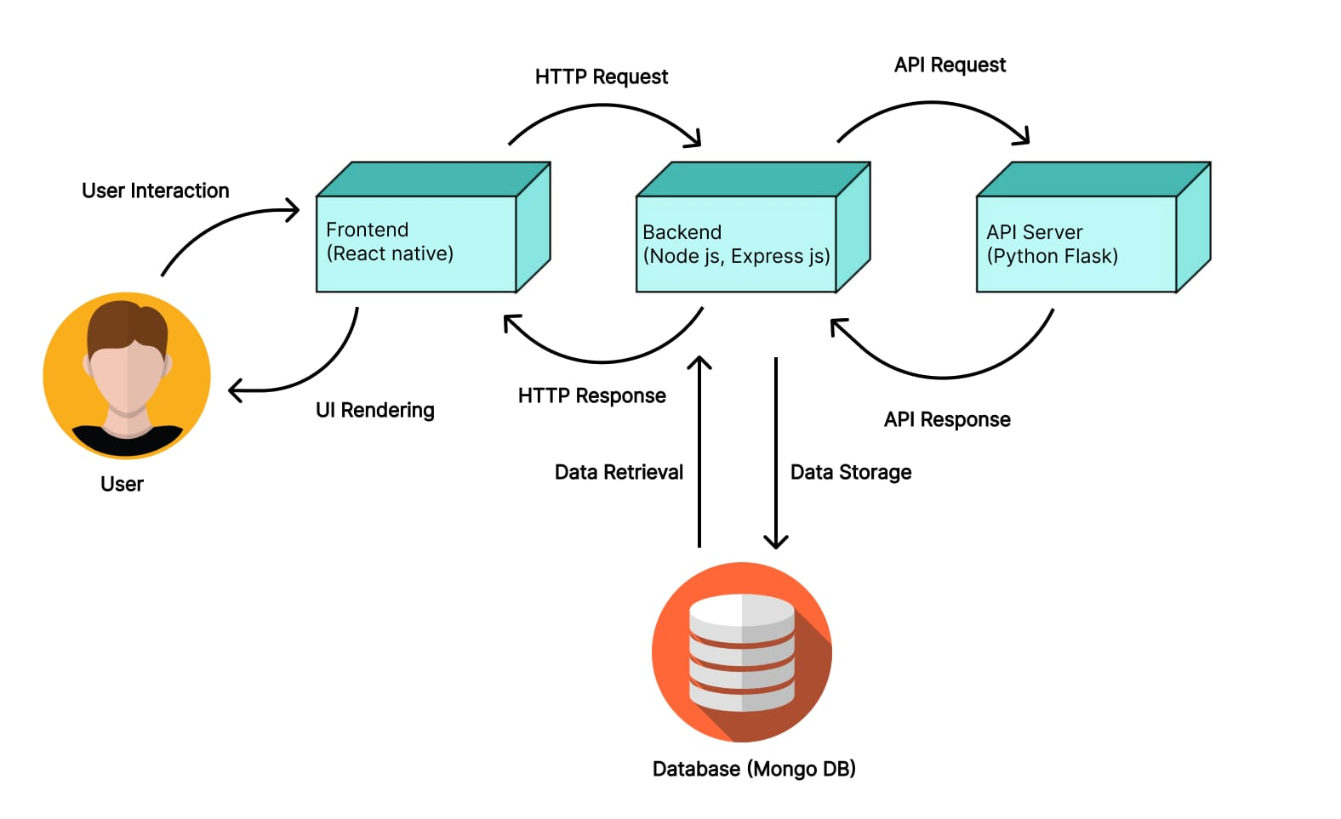
Department of CSE-AI & ML (CSM)
Team:BATCH17
21BQ5A4206, 21BQ5A4204,
21BQ5A4205, 21BQ5A4201
System Architecture

Slide 10
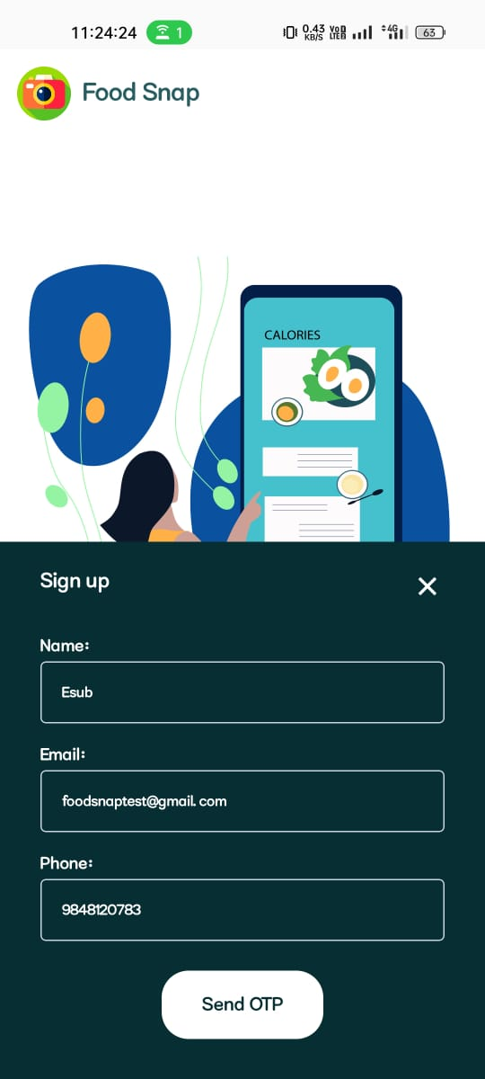
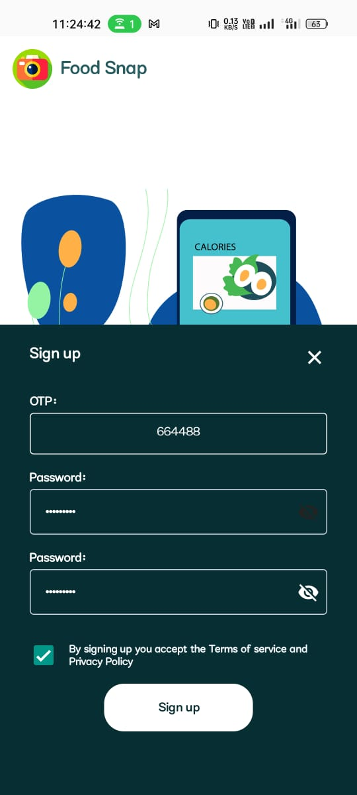
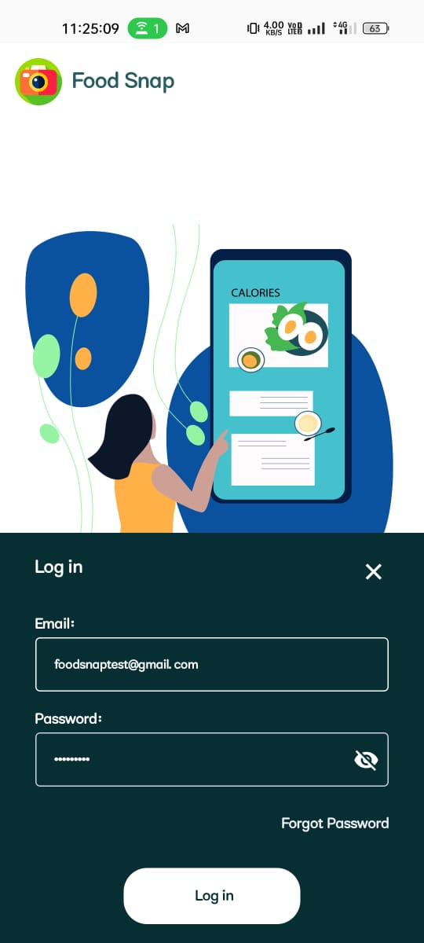
Department of CSE-AI & ML (CSM)
Team:BATCH17
21BQ5A4206, 21BQ5A4204,
21BQ5A4205, 21BQ5A4201
User Registration and Profile: The feature allows users to create accounts and personalize profiles with dietary preferences and personal information, facilitating a tailored experience.

Slide 11
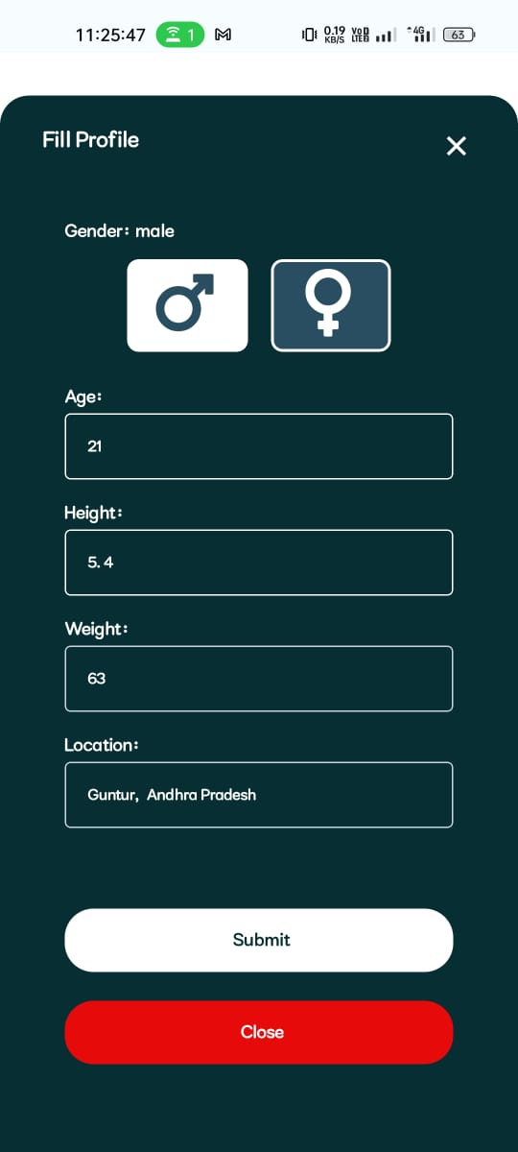
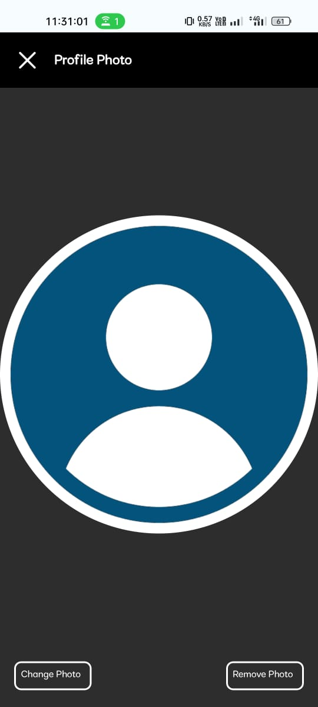
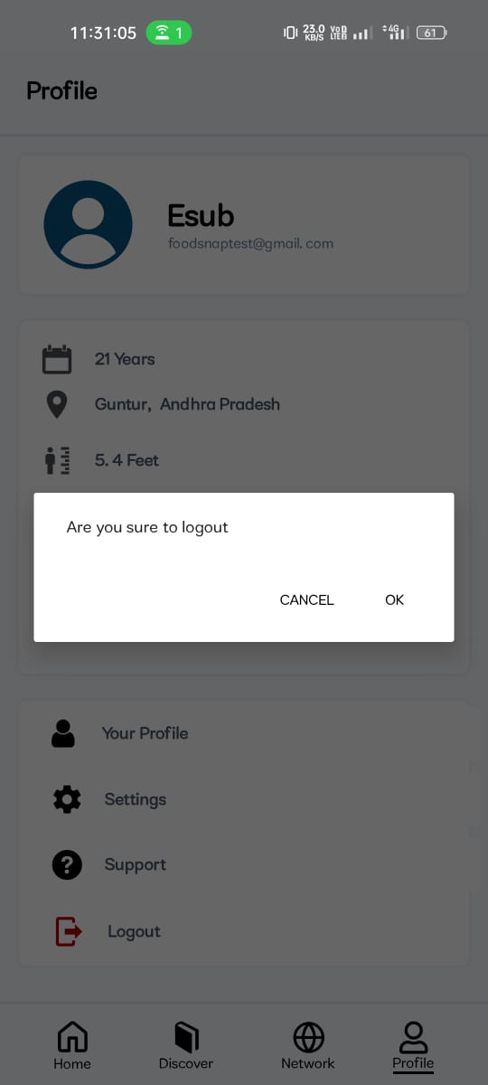
Department of CSE-AI & ML (CSM)
Team:BATCH17
21BQ5A4206, 21BQ5A4204,
21BQ5A4205, 21BQ5A4201

Slide 12
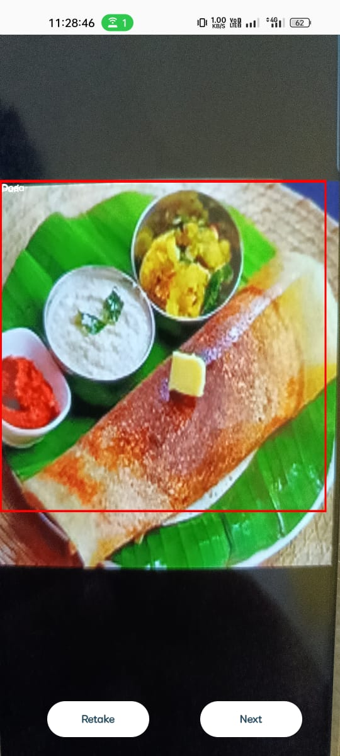
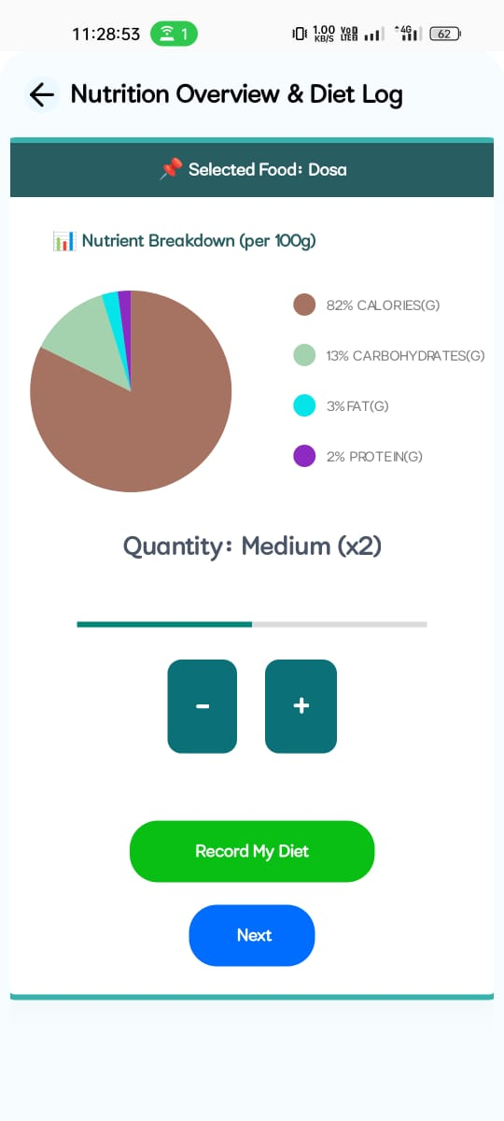
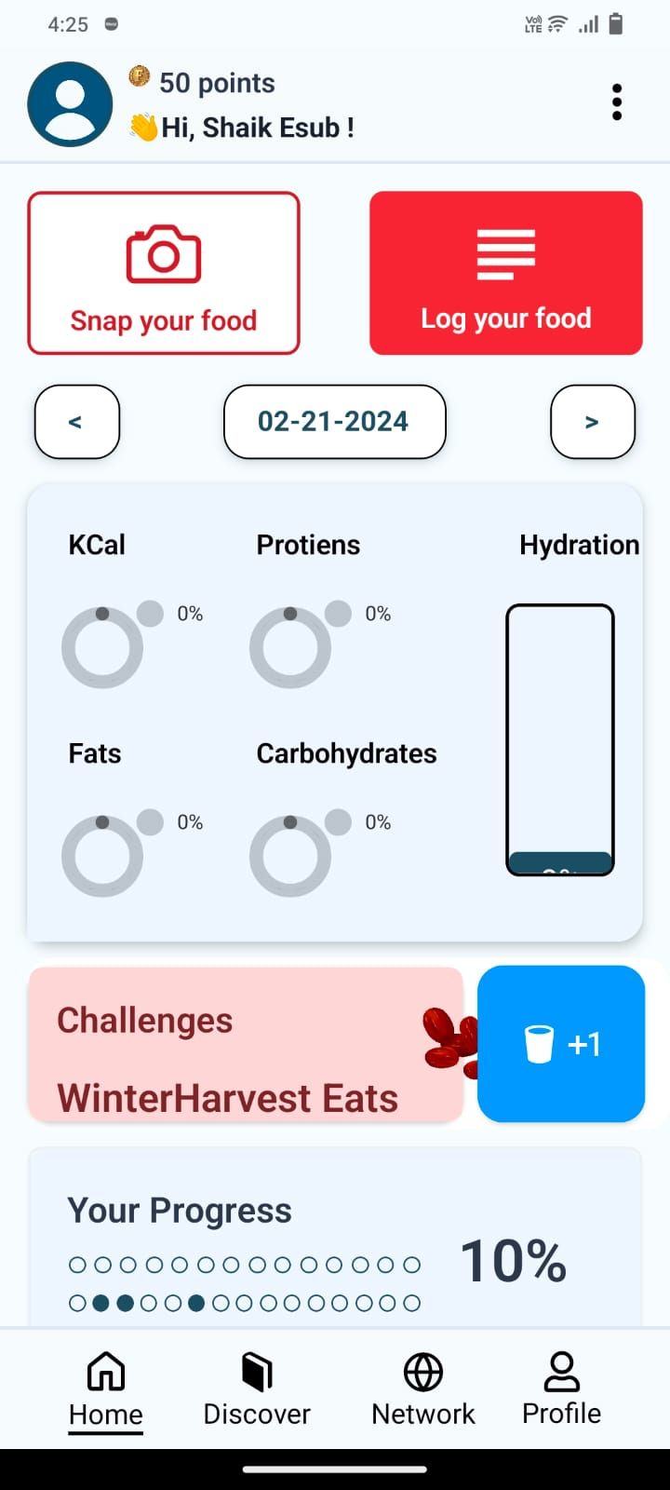
Department of CSE-AI & ML (CSM)
Team:BATCH17
21BQ5A4206, 21BQ5A4204,
21BQ5A4205, 21BQ5A4201
Nutritional Analysis:: Through advanced Deep Learning algorithms and a vast food database the application provides detailed nutritional information for food items, including calories, macronutrients, micronutrients composition, ensuring users have comprehensive insights into their dietary intake.

Slide 13
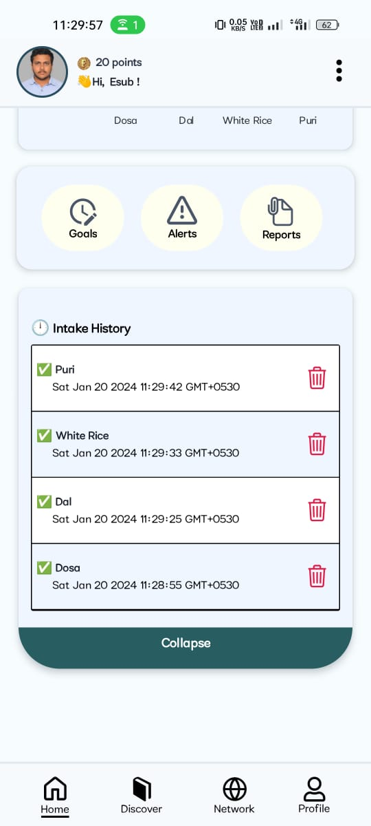
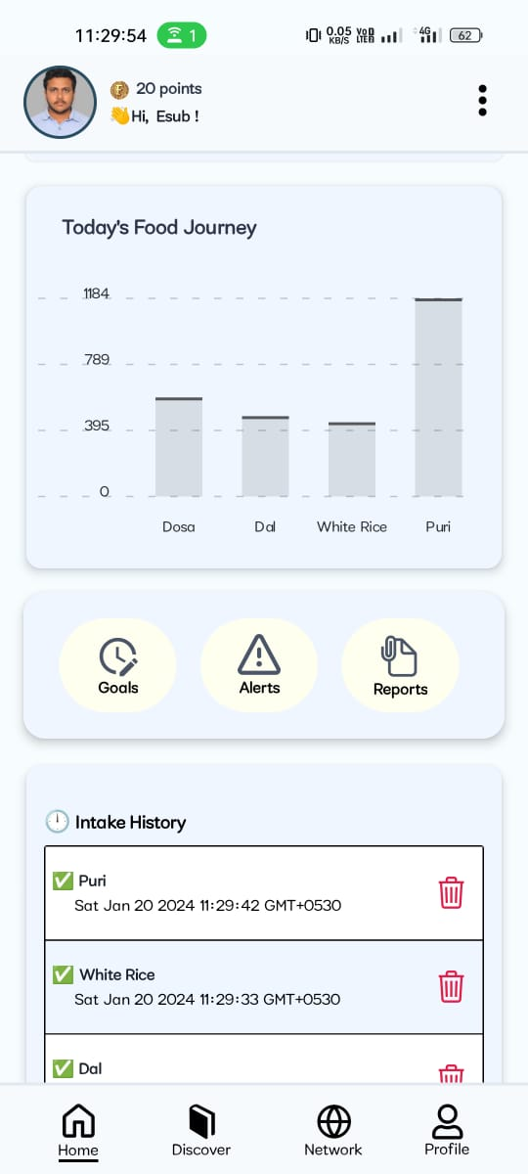
Department of CSE-AI & ML (CSM)
Team:BATCH17
21BQ5A4206, 21BQ5A4204,
21BQ5A4205, 21BQ5A4201
Meal History and Tracking:With this feature users can easily track their food intake over time, accessing a detailed history of meals consumed, aiding in understanding eating patterns and making informed dietary choices.

Slide 14
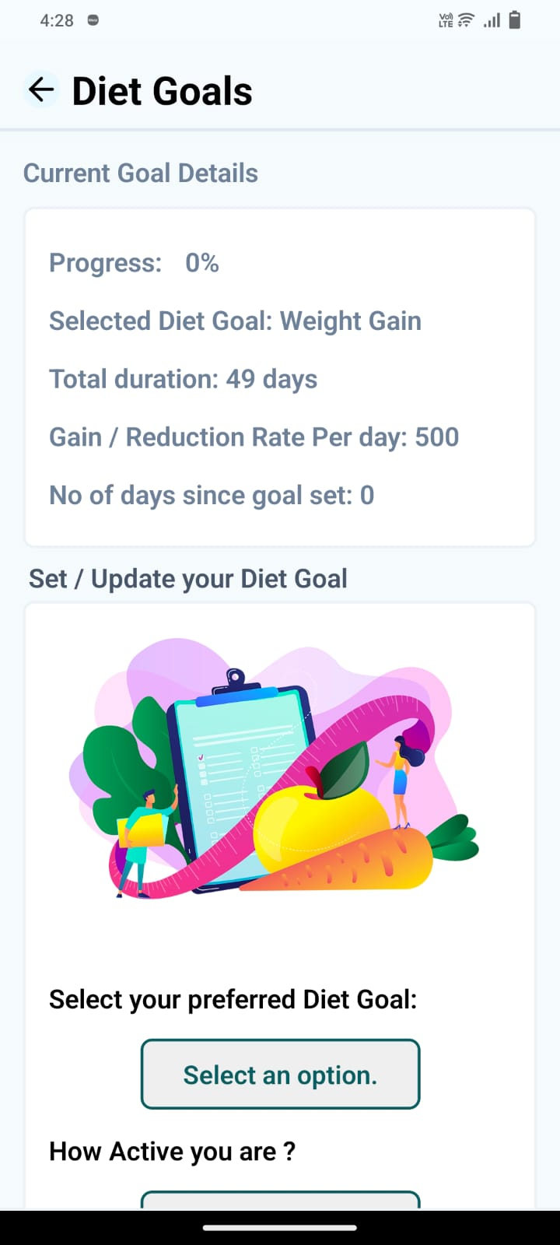
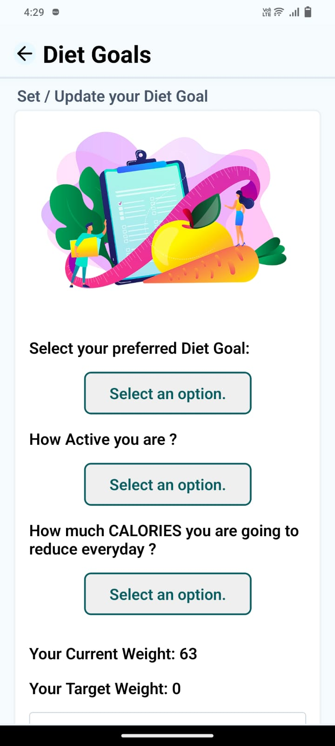
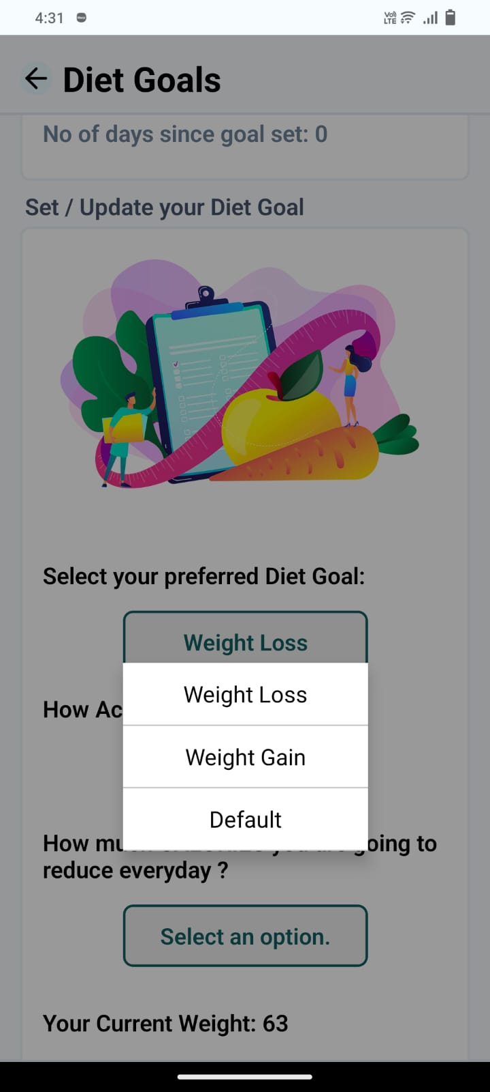
Department of CSE-AI & ML (CSM)
Team:BATCH17
21BQ5A4206, 21BQ5A4204,
21BQ5A4205, 21BQ5A4201
Goals Setting and Tracking: This feature empowers users to set dietary goals such as calorie intake, macronutrient distribution, or specific dietary targets, and tracks their progress towards achieving these goals, fostering accountability and motivation.

Slide 15
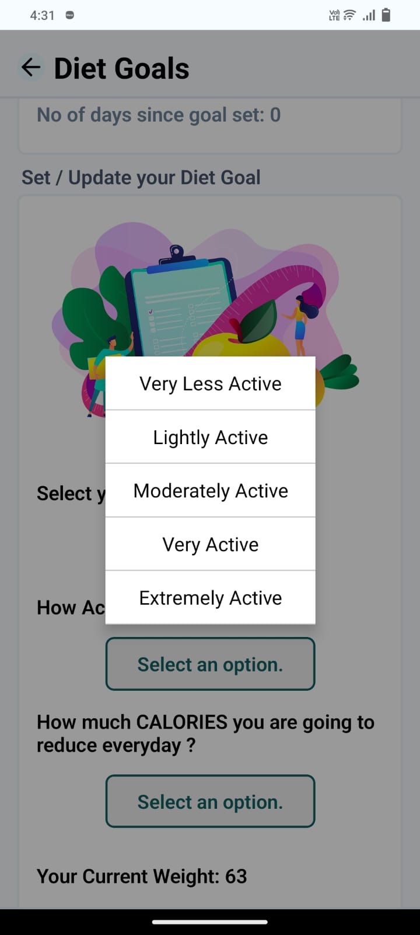
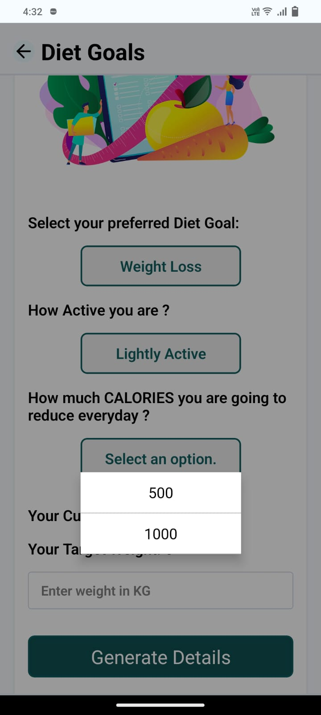
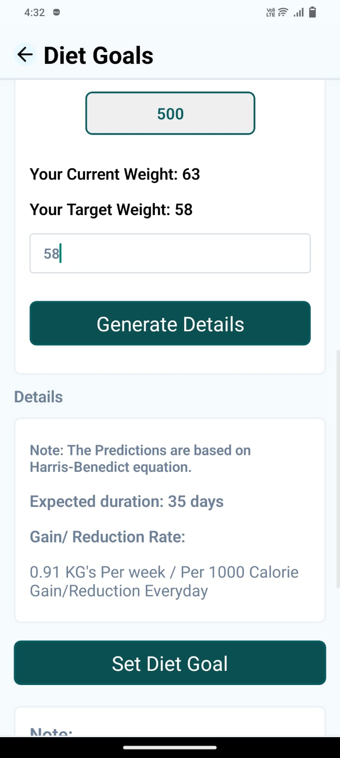

Department of CSE-AI & ML (CSM)
Team:BATCH17
21BQ5A4206, 21BQ5A4204,
21BQ5A4205, 21BQ5A4201

Slide 16
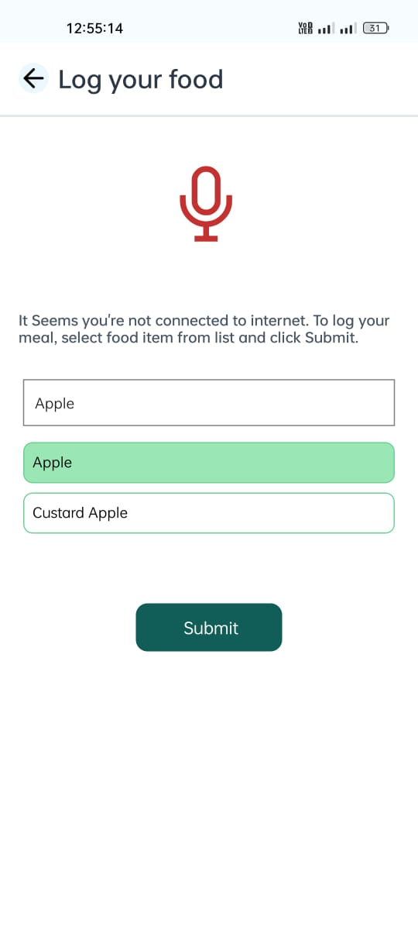
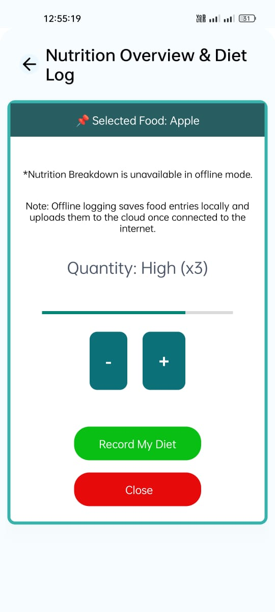
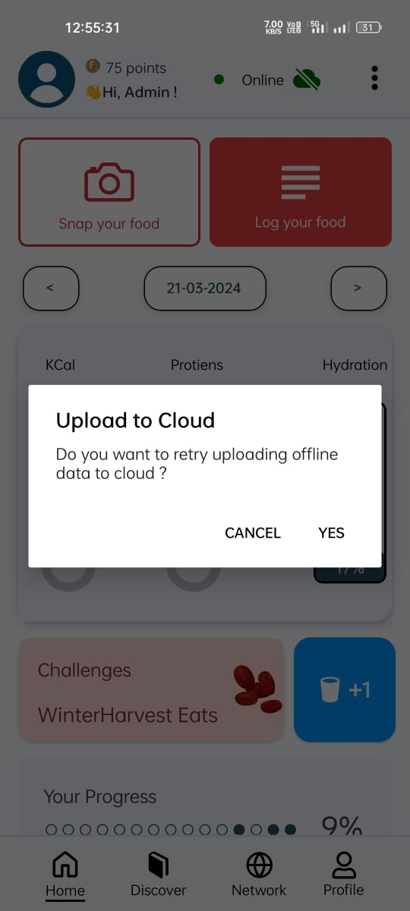
Department of CSE-AI & ML (CSM)
Team:BATCH17
21BQ5A4206, 21BQ5A4204,
21BQ5A4205, 21BQ5A4201
Offline Functionality: We included an Offline Functionality feature to log food data even when a user is not connected to the internet. It uploads the data to the cloud once an internet connection is established.

Slide 17
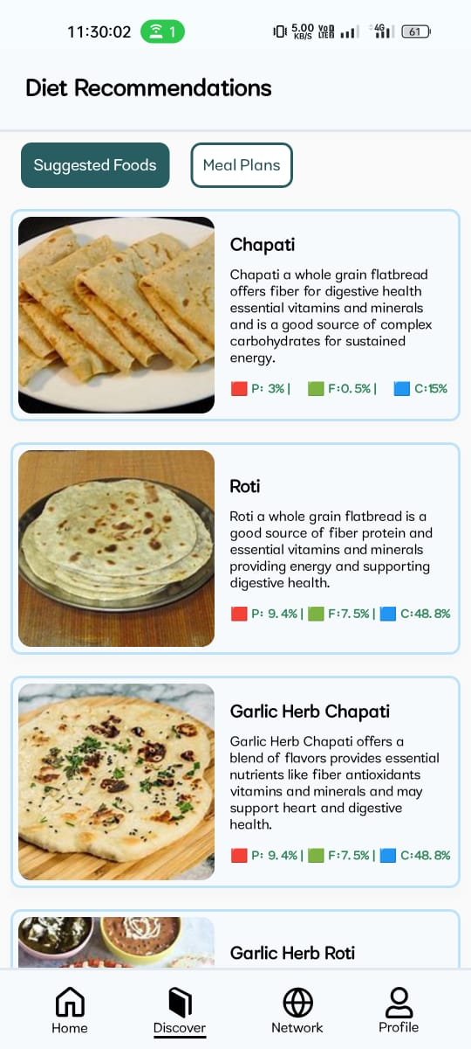
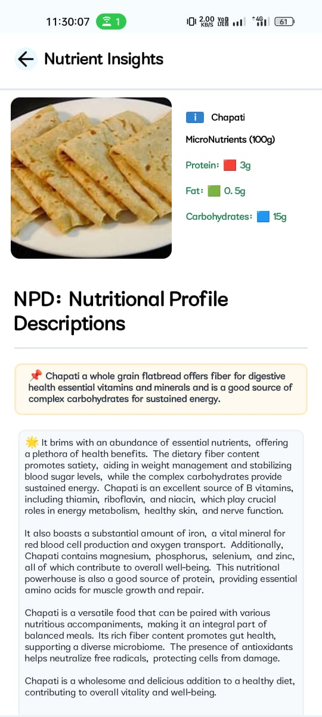
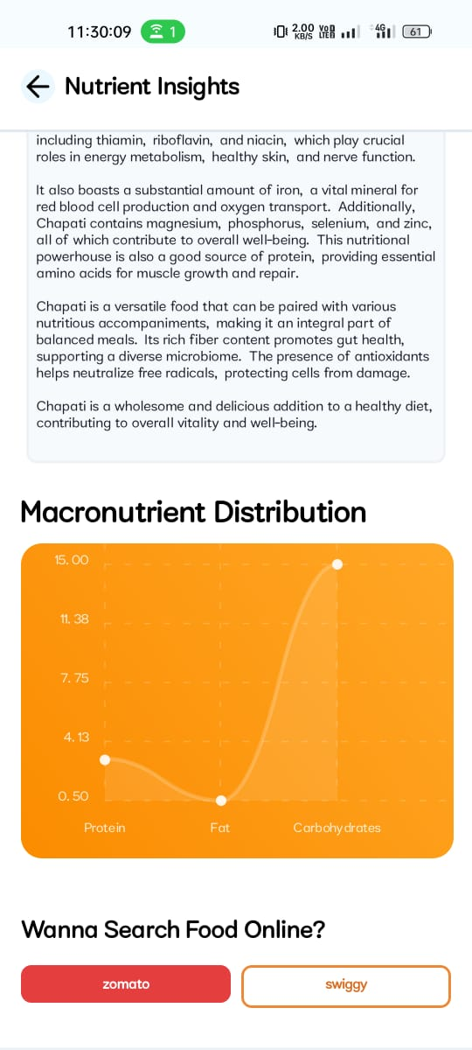
Department of CSE-AI & ML (CSM)
Team:BATCH17
21BQ5A4206, 21BQ5A4204,
21BQ5A4205, 21BQ5A4201
Personalized Recommendations:Leveraging user profiles and dietary data, the application generates personalized meal suggestions and dietary recommendations tailored to individual preferences and nutritional needs, guiding users towards healthier eating habits.

Slide 18
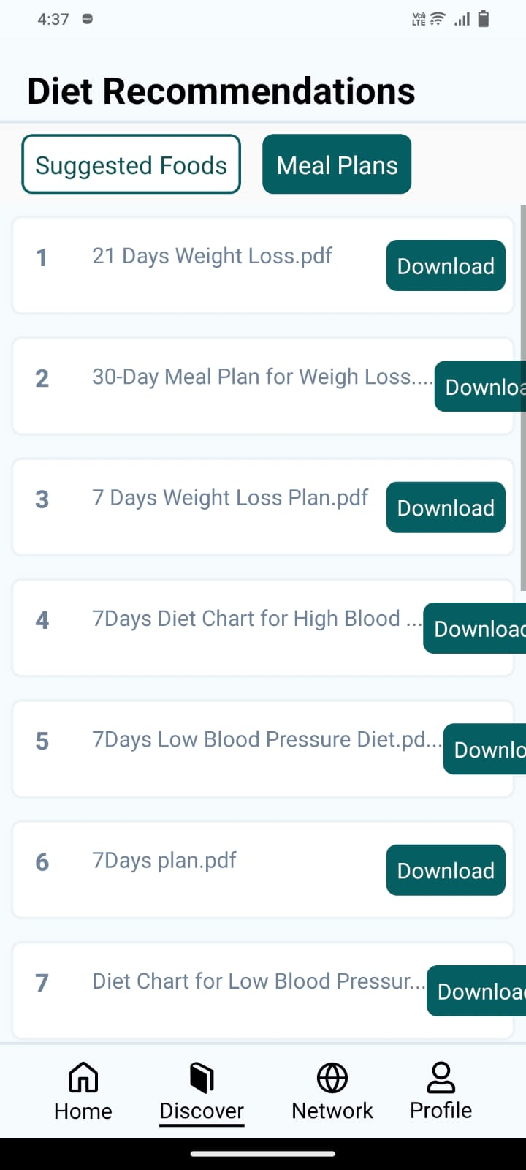
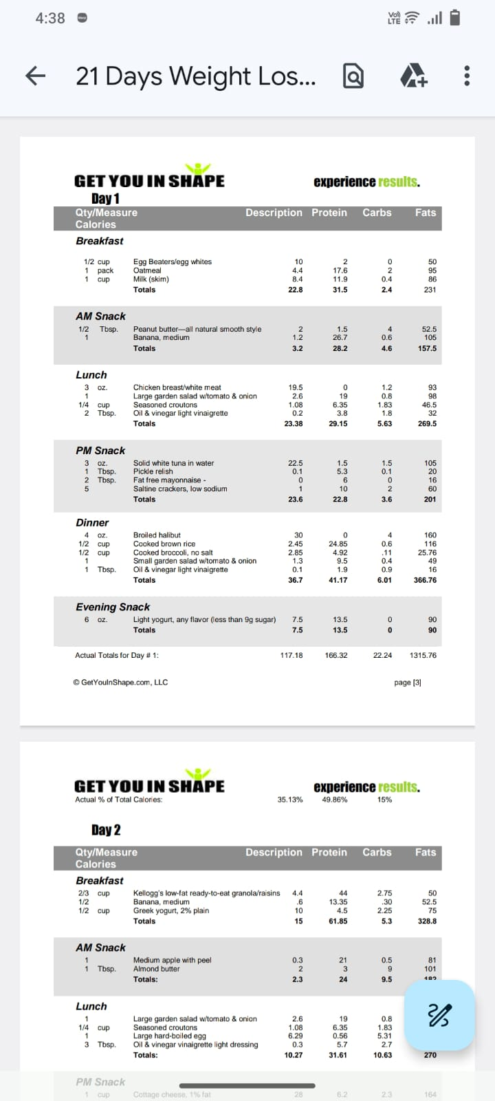
Department of CSE-AI & ML (CSM)
Team:BATCH17
21BQ5A4206, 21BQ5A4204,
21BQ5A4205, 21BQ5A4201

Slide 19
Department of CSE-AI & ML (CSM)
Team:BATCH17
21BQ5A4206, 21BQ5A4204,
21BQ5A4205, 21BQ5A4201
Visual Analytics: : The analytics are displayed in Pie charts for each food intake. The intuitive navigation feature enables us to retrieve information with just a single click, and changes the charts and graphs dynamically based on the selected date.

Slide 20
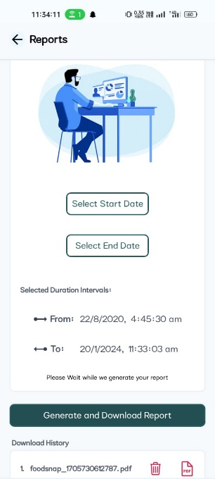
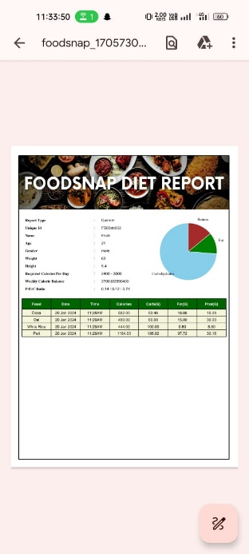
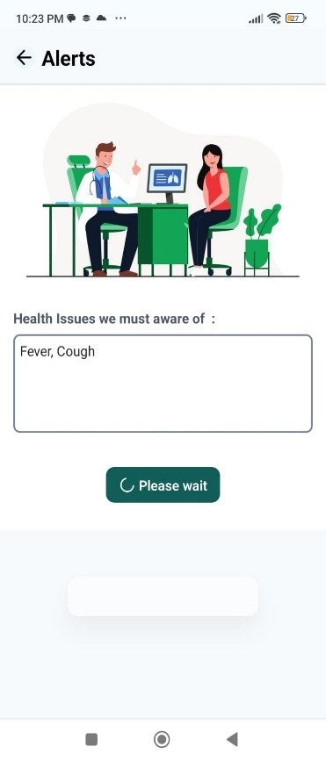
Department of CSE-AI & ML (CSM)
Team:BATCH17
21BQ5A4206, 21BQ5A4204,
21BQ5A4205, 21BQ5A4201
Reports and Reminders: Reports Feature allows users to generate a diet report that include Protein: Fat: Carbohydrate Ratio, Personal Details and Analytical Information with our required Start and End dates. The Reminders allows the user to get alerts when a food item is not recommended to eat based on our health condition and to notify about the food log to the user

Slide 21
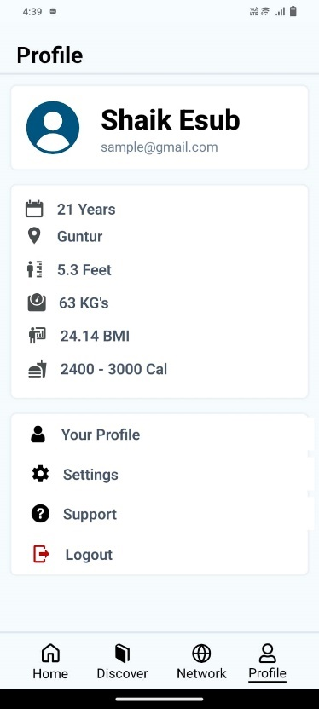
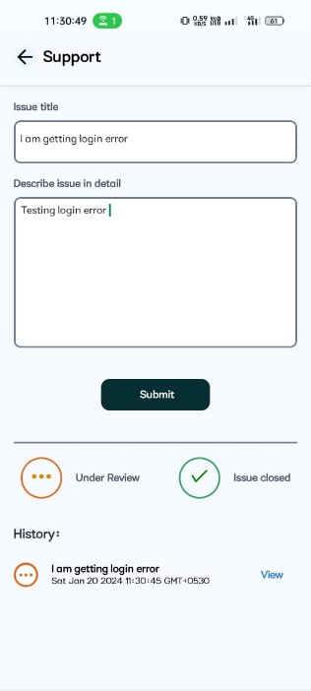
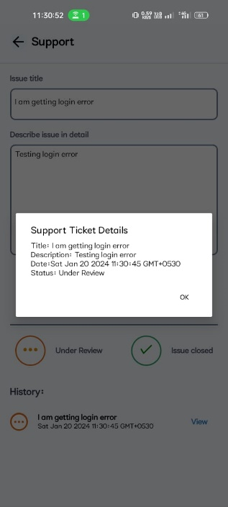
Department of CSE-AI & ML (CSM)
Team:BATCH17
21BQ5A4206, 21BQ5A4204,
21BQ5A4205, 21BQ5A4201
Optional Features: The Profile page allows the user to update their personal details, The support page is used to describe any issues or difficulties they face while using the application to the developers/administrators and it also provides meal plans to follow for users and Community achievement points to encourage user participation.

Slide 22
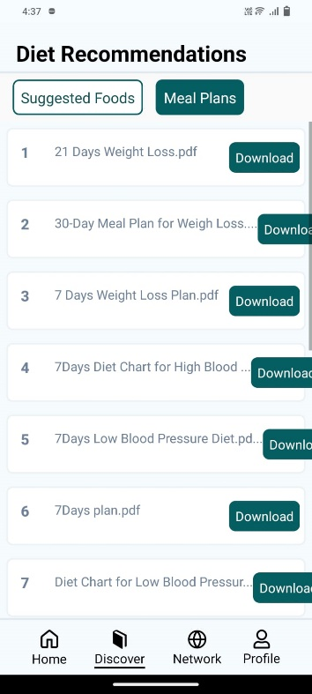
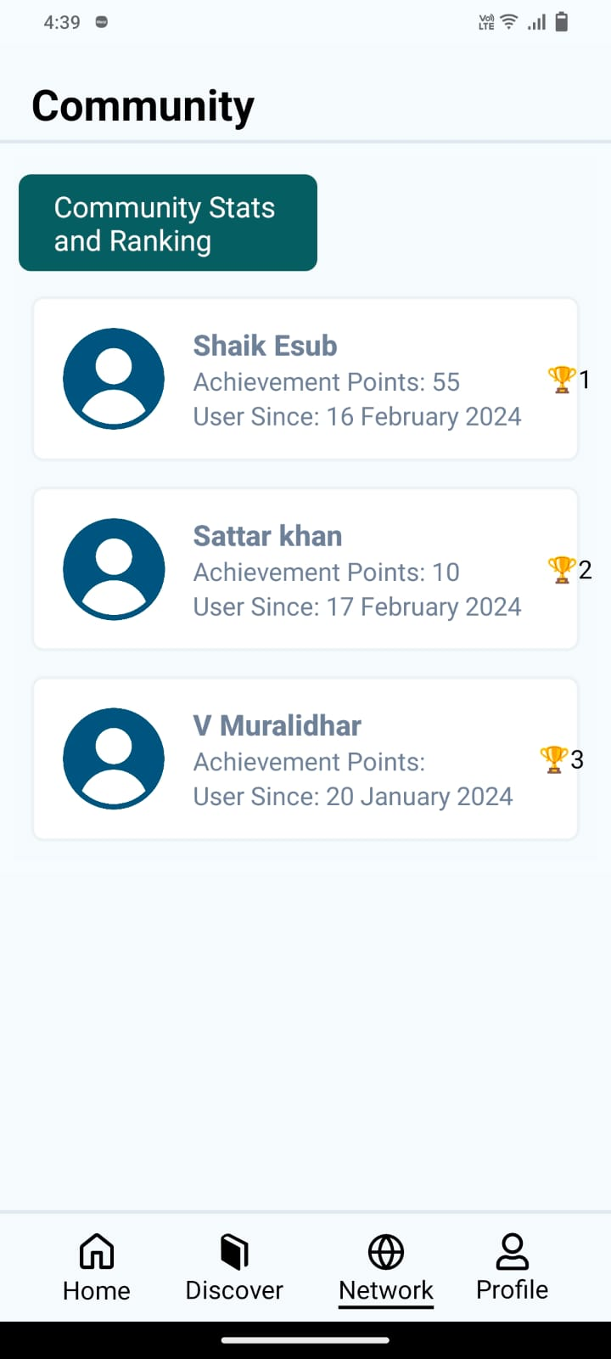
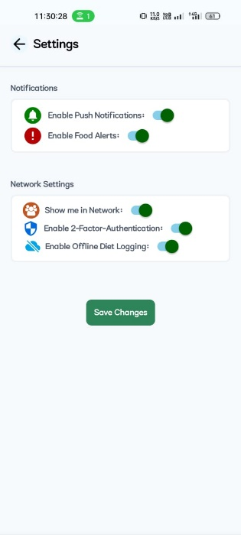
Department of CSE-AI & ML (CSM)
Team:BATCH17
21BQ5A4206, 21BQ5A4204,
21BQ5A4205, 21BQ5A4201

